Slide 1
Heuristic Search
introduction
Hill-Climbing
Dynamic Programming
The Best-first Search Algorithm
Admissibility, Monotonicity, and informedness
Using Heuristics in Games.

Slide 2
Heuristic
Heuristic – the study of the methods and rules of discovery and invention
State Space Heuristics – Formalized as rules for choosing those branches in a state space that are most likely to lead to an acceptable problem solution
Apply Heuristics When:
A problem is ambiguous and may not have an EXACT solution
Eg: Medical diagnosis
The computational cost of finding an exact solution is prohibitive.
Eg: Chess – where the number of possible states increases exponentially or factorially with the depth of the search.
Heuristics guide the search along the most “promising” path through space – Informed Search.
Eliminates unpromising states and their descendants from consideration and finds an acceptable solution

Slide 3
Inherent limitation of heuristic search
• Heuristic is only an informed guess of the next step to be taken in solving a problem
• Heuristics use limited information, so they are seldom able to predict the exact behavior of the state space farther along in the search
•A heuristic can lead a search algorithm to a suboptimal solution or fail to find any solution at all

Slide 4
Importance of heuristics
It is not feasible to examine every inference that can be made in a mathematics domain
Heuristic search is often the only practical answer
Reduce complex information to a simple and manageable set of choices
Help people turn an intention into a realized action
Provide quick and relatively inexpensive feedback to designers

Slide 5
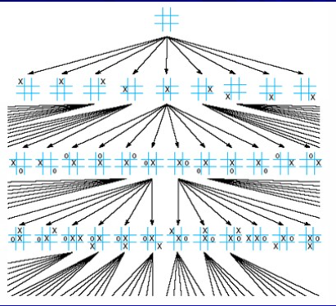
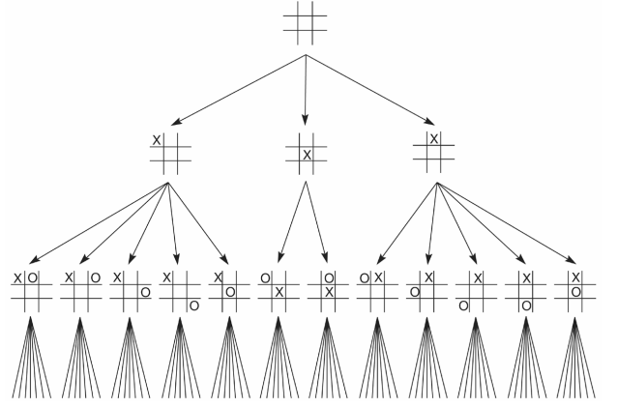
TIC-TAC-TOE
Total number of states that need to be considered in an exhaustive search at 9x8x7x….or 9!
Symmetry reductions on the second level further reduce the number of paths through the space to 12x7!

Slide 6
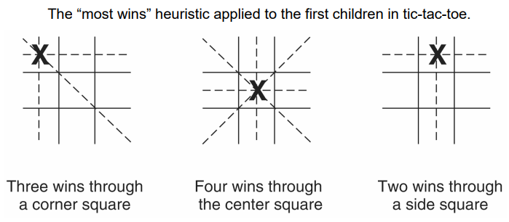

Slide 7
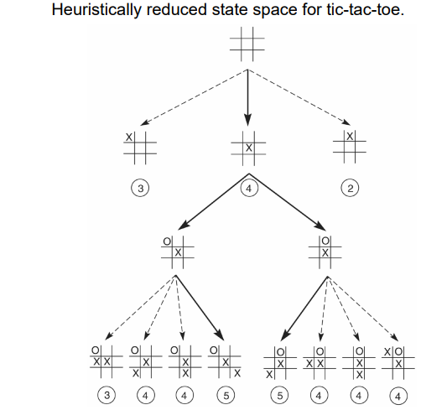

Slide 8
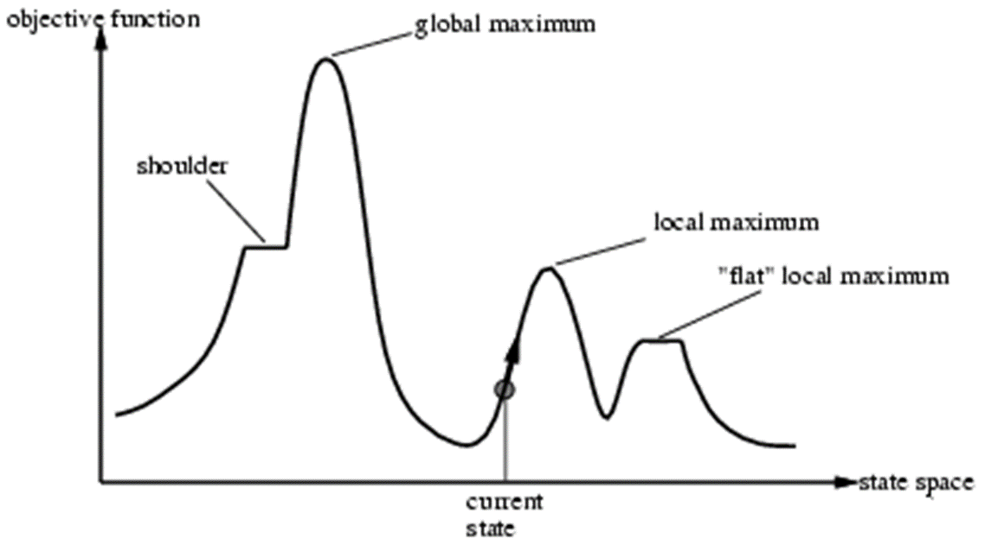
Hill climbing
• Hill climbing strategies expand the current state in the search and evaluate its children
• The best child is selected for further expansion; neither its siblings nor its parent are retained
• Search halts when it reaches a state that is better than any of its children
• Go uphill along the steepest possible path until it can go no farther
• Keeps no history, hence the algorithm cannot recover from failures of its strategy

Slide 9
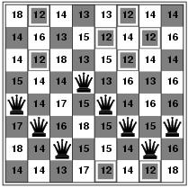
Hill-climbing search: 8-Queens problem
h = number of pairs of queens that are attacking each other, either directly or indirectly
h = 17 for the above state

Slide 10
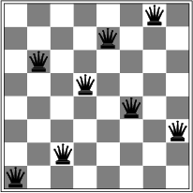
Hill-climbing search: 8-Queens problem
A local minimum with h = 1

Slide 11
Dynamic Programming
Sometimes called the forward-backward. or, when using probabilities, the Viterbi algorithm.
DP keeps track of and reuses subproblems already searched and solved within the solution of the larger problem.
Used in
Optimal Global Alignment
Minimum Edit Distance Between two strings

Slide 12
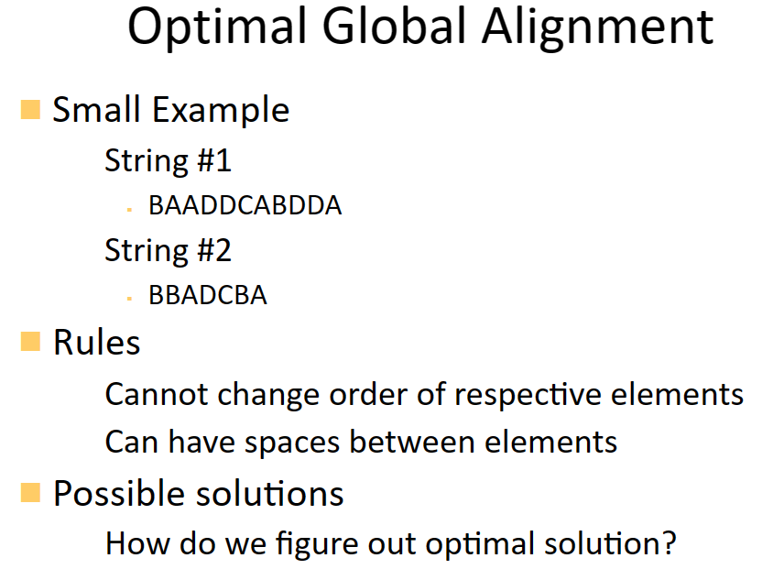

Slide 13
OPTIMAL GLOBAL ALIGNMENT
The forward stage
Fill the array from the upper left corner
The value of (x,y) is a function
min cost( (x-1,y), (x-1,y-1), (x, y-1)‏ )
If there is a match: Add 0 to (x-1,y-1)‏
If there is no match: Add 2 to (x-1,y-1)‏
If we shift: Add 1 to the previous column
If we insert a character: Add 1 to the previous row

Slide 14
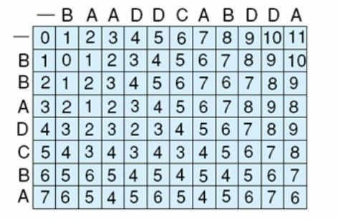
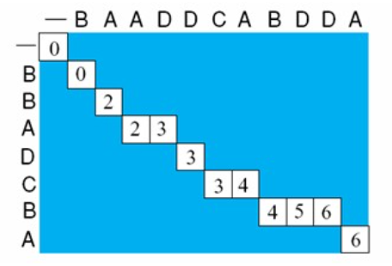

The backward stage
Once the matrix is filled
From the best alignment count, we produce a specific alignment of characters
Begin at the lower right-hand corner
Move back through the matrix
Each step, select one of the immediate state’s predecessors (previous diagonal, row, or column)‏➔ Choose the minimum

Slide 15
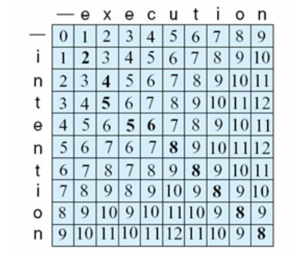
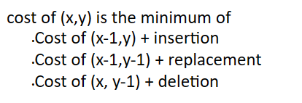
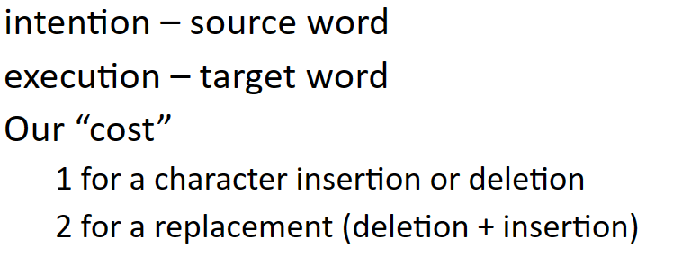
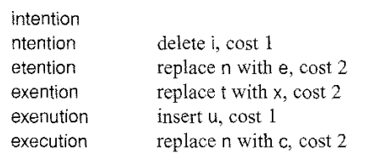
Min Edit Distance Spell Checker
What words from our dictionary best approximate a word we do not recognize (misspelled word)‏
We need to know the “distance” between two words Minimum edit distance
The number of insertions, deletions and replacements to turn the source word into the target word

Slide 16
Best-First Search Algorithm
Hill climbing tends to become stuck at local maxima
If they reach a state that has a better evaluation than any of its children, the algorithm halts
Hill climbing can be used effectively if the evaluation function is sufficiently informative to avoid local maxima and infinite paths
Heuristic search requires a more flexible algorithm: this is provided by best-first search, where, with a priority queue, recovery from local maxima is possible

Slide 17
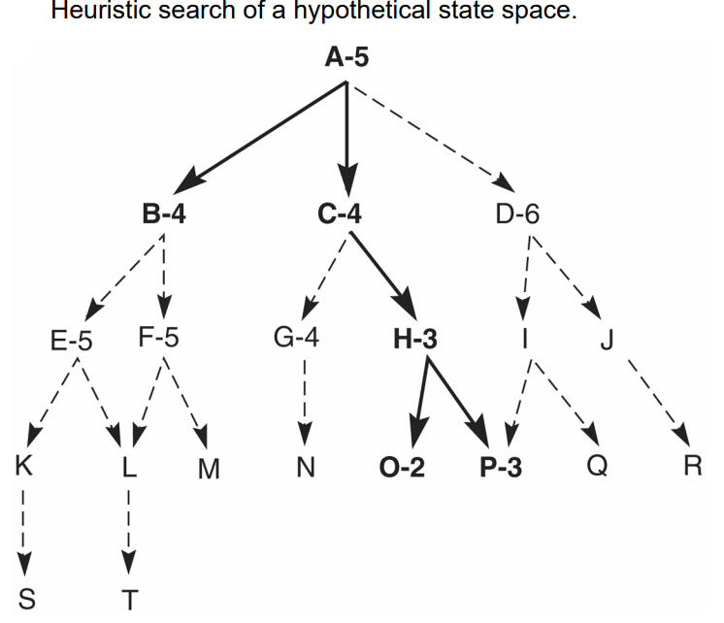
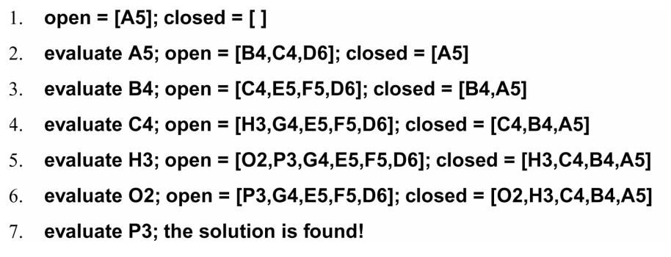

Slide 18
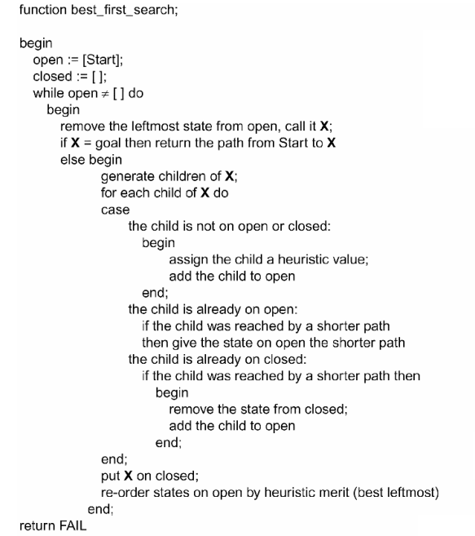

Slide 19
The best-first search algorithm always select the most promising state on open for further expansion
it is using a heuristic that may prove erroneous, it does not abandon all the other states but maintains then on open
In the event a heuristic leads the search down a path that proves incorrect, the algorithm will eventually retrieve some previously generated, “next best” state from open and shift its focus to another part of the space
In best-first search, as in depth-first and breadth-first search algorithms, the open list allows backtracking from paths that fail to produce a goal

Slide 20
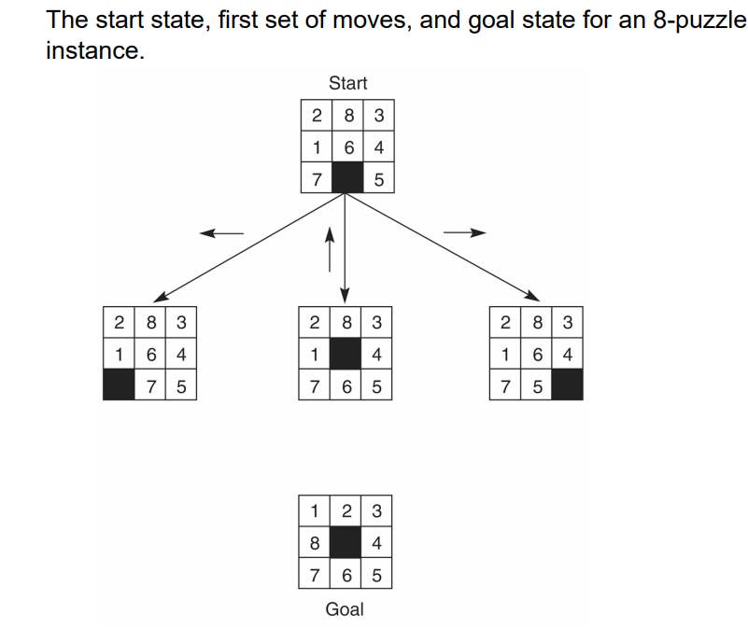

Slide 21
Informed (Heuristic) Search Strategies
Informed Search – a strategy that uses problem-specific knowledge beyond the definition of the problem itself
Best-First Search – an algorithm in which a node is selected for expansion based on an evaluation function f(n)
Traditionally the node with the lowest evaluation function is selected
Choose the node that appears to be the best

Slide 22
Best-first search
Idea: use an evaluation function f(n) for each node
estimate of "desirability"
Expand most desirable unexpanded node
Implementation:
Order the nodes in decreasing order of desirability
Special cases:
greedy best-first search
A* search

Slide 23
Greedy best-first search
Evaluation function f(n) = h(n) (heuristic)
= estimate of cost from n to goal
e.g., h_{SLD}(n) = straight-line distance from n to goal
Greedy best-first search expands the node that appears to be closest to goal

Slide 24
A* search
Idea: avoid expanding paths that are already expensive
Evaluation function f(n) = g(n) + h(n)
g(n) = cost so far to reach n
h(n) = estimated cost from n to goal
f(n) = estimated total cost of path through n to goal

Slide 25
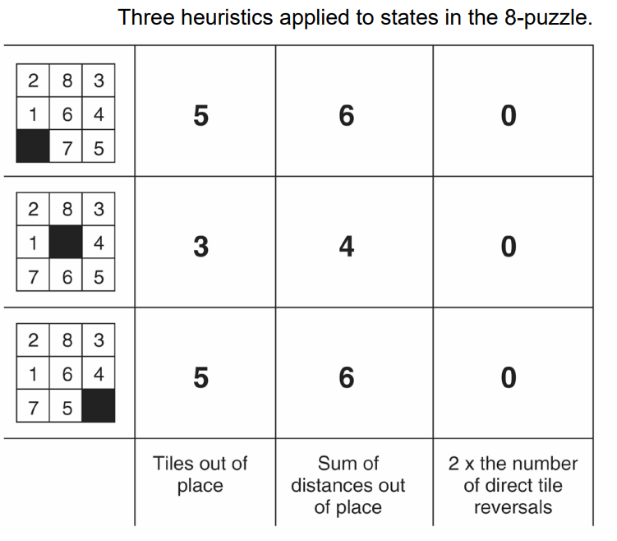
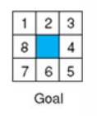

Slide 26
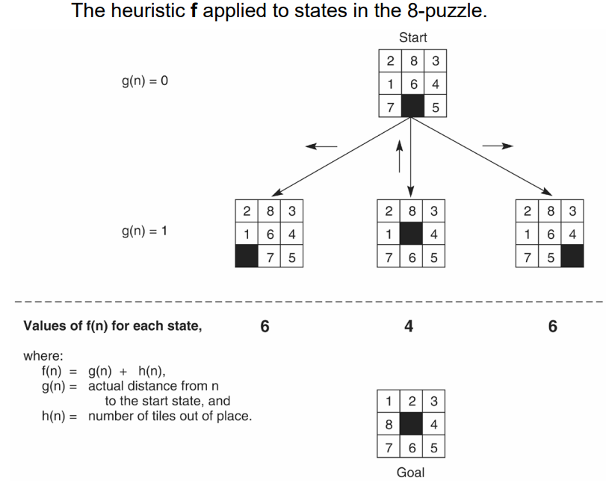

Slide 27
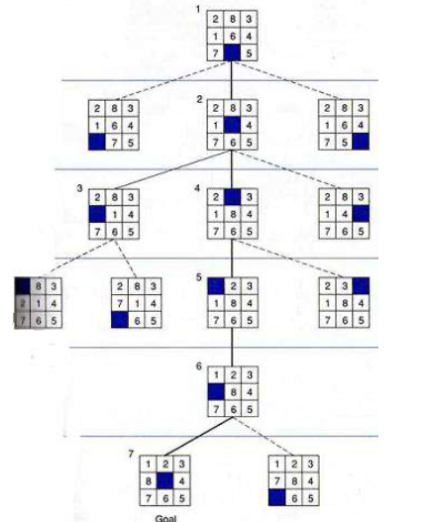

Slide 28
Admissibility, Monotonicity & Informedness

Slide 29
Admissible heuristics
A heuristic h(n) is admissible if for every node n,
h(n) ≤ h*(n), where h*(n) is the true cost to reach the goal state from n.
An admissible heuristic never overestimates the cost to reach the goal, i.e., it is optimistic
Theorem: If h(n) is admissible, A* using TREE-SEARCH is optimal

Slide 30
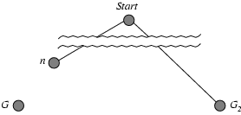
Optimality of A*
Suppose some suboptimal goal G₂ has been generated and is in the fringe. Let n be an unexpanded node in the fringe such that n is on a shortest path to an optimal goal G.
f(G₂) = g(G₂) since h(G₂) = 0
g(G₂) > g(G) since G₂ is suboptimal
f(G) = g(G) since h(G) = 0
f(G₂) > f(G) from above

Slide 31
Optimality of A*
Suppose some suboptimal goal G₂ has been generated and is in the fringe. Let n be an unexpanded node in the fringe such that n is on a shortest path to an optimal goal G.
f(G₂) > f(G) from above
h(n) ≤ h*(n) since h is admissible
g(n) + h(n) ≤ g(n) + h*(n)
f(n) ≤ f(G)
Hence f(G₂) > f(n), and A* will never select G₂ for expansion

Slide 32
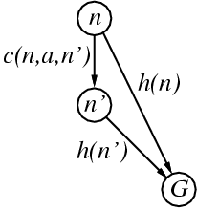
Consistent heuristics / Monotonicity
A heuristic is consistent/monotone if for every node n, every successor n' of n generated by any action a,
h(n) ≤ c(n,a,n') + h(n')
If h is consistent, we have
f(n') = g(n') + h(n')
= g(n) + c(n,a,n') + h(n')
≥ g(n) + h(n)
= f(n)
i.e., f(n) is non-decreasing along any path.
Theorem: If h(n) is consistent, A* using GRAPH-SEARCH is optimal

Slide 33
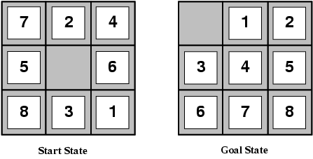
Admissible heuristics
E.g., for the 8-puzzle:
h₁(n) = number of misplaced tiles
h₂(n) = total Manhattan distance
(i.e., no. of squares from desired location of each tile)
h₁(S) = ?
h₂(S) = ?

Slide 34
Admissible heuristics
E.g., for the 8-puzzle:
h₁(n) = number of misplaced tiles
h₂(n) = total Manhattan distance
(i.e., no. of squares from desired location of each tile)
h₁(S) = ? 8
h₂(S) = ? 3+1+2+2+2+3+3+2 = 18

Slide 35
Dominance/ Informedness
If h₂(n) ≥ h₁(n) for all n (both admissible),
then h₂ dominates h₁ ➔h₂ is better for search
Typical search costs (average number of nodes expanded):
d=12, IDS = 3,644,035 nodes A*(h₁) = 227 nodes A*(h₂) = 73 nodes
d=24 IDS = too many nodes A*(h₁) = 39,135 nodes A*(h₂) = 1,641 nodes

Slide 36
Adversarial Search

Slide 37
Games vs. search problems
"Unpredictable" opponent → specifying a move for every possible opponent reply
Time limits → unlikely to find goal, must approximate

Slide 38
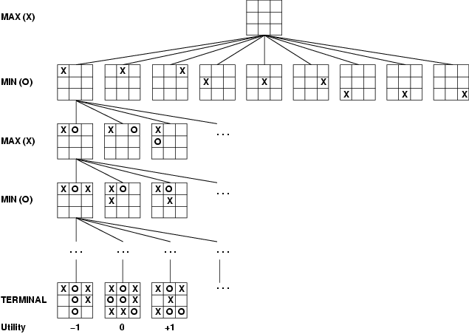
Game tree (2-player, deterministic, turns, zero-sum)

Slide 39
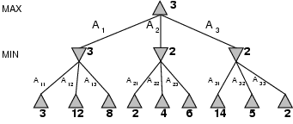
Minimax
Perfect play for deterministic games Idea: choose move to position with highest minimax value = best achievable payoff against best play E.g., 2-ply game:

Slide 40
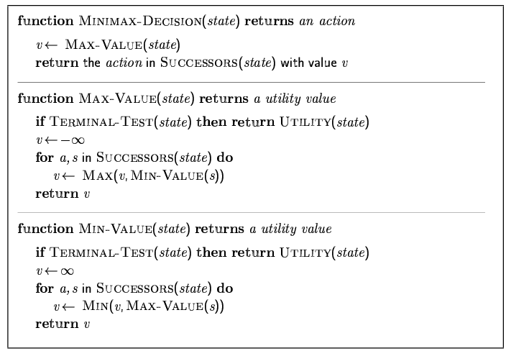
Minimax algorithm

Slide 41
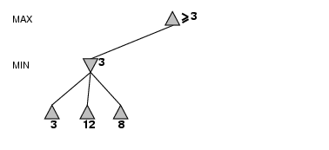
α-β pruning example

Slide 42
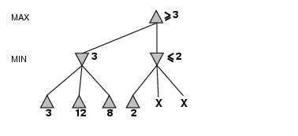
α-β pruning example

Slide 43
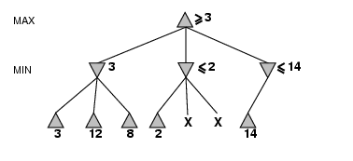
α-β pruning example

Slide 44
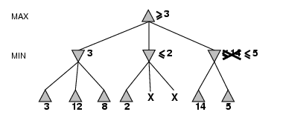
α-β pruning example

Slide 45
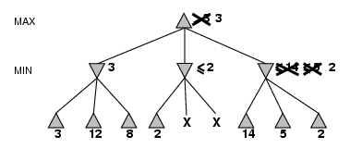
α-β pruning example

Slide 46
Properties of α-β
Pruning does not affect final result Good move ordering improves effectiveness of pruning With "perfect ordering," time complexity = O(b^{m/2})
→ doubles depth of search

Slide 47
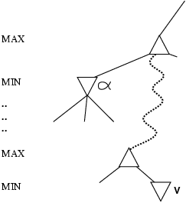
Why is it called α-β?
α is the value of the best (i.e., highest-value) choice found so far at any choice point along the path for max If v is worse than α, max will avoid it → prune that branch Define β similarly for min

Slide 48
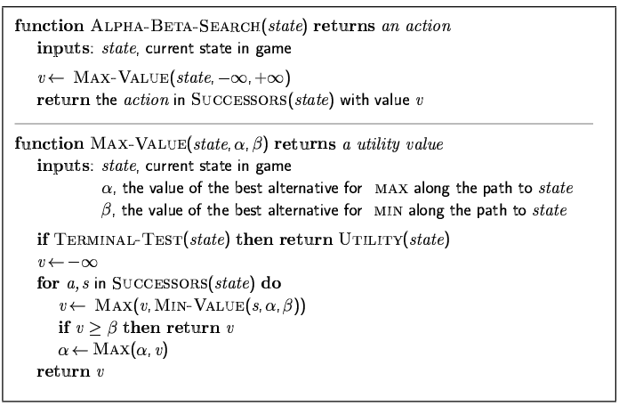
The α-β algorithm

Slide 49
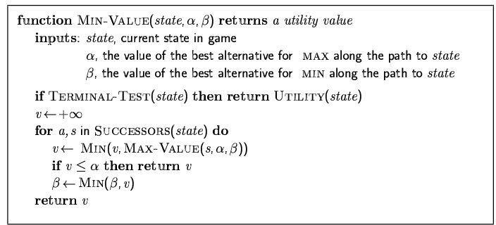
The α-β algorithm

Slide 50
Evaluation functions
For chess, typically linear weighted sum of features
Eval(s) = w₁ f₁(s) + w₂ f₂(s) + … + w_{n} f_{n}(s)
e.g., w₁ = 9 with
f₁(s) = (number of white queens) – (number of black queens), etc.

Slide 51
Cutting off search
MinimaxCutoff is identical to MinimaxValue except
Terminal? is replaced by Cutoff?
Utility is replaced by Eval
Does it work in practice? b^{m} = 10⁶, b=35 → m=4 4-ply lookahead is a hopeless chess player!
4-ply ≈ human novice
8-ply ≈ typical PC, human master
12-ply ≈ Deep Blue, Kasparov

